Slide 1
Illustrations
Introduction to LabBench

Slide 2
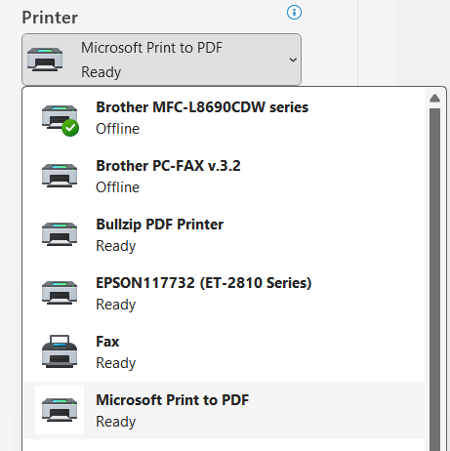

Slide 3
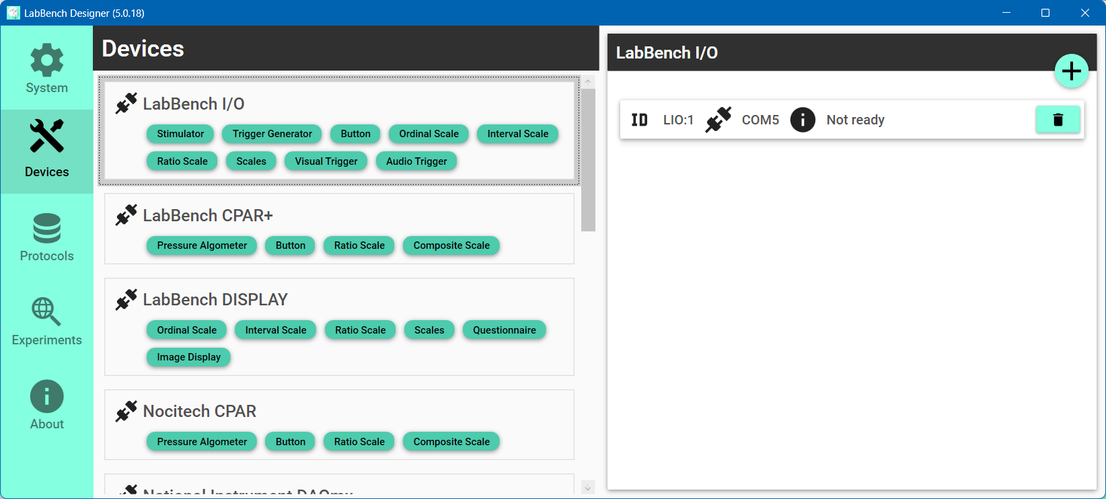

Slide 4

Select the Devices page
Click the “Scan and add” button
Select the type of instrument to add

Slide 5
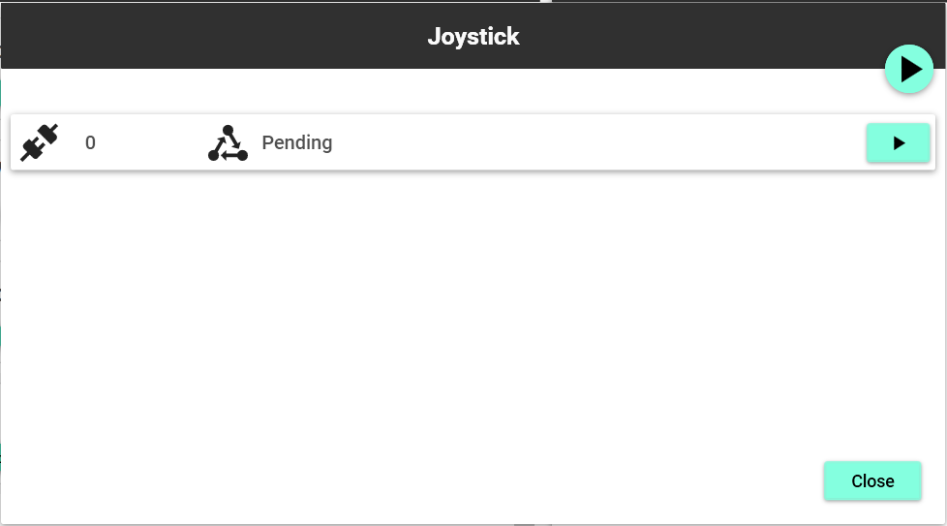
“Scan all connections” button
“Scan connection” button

Slide 6
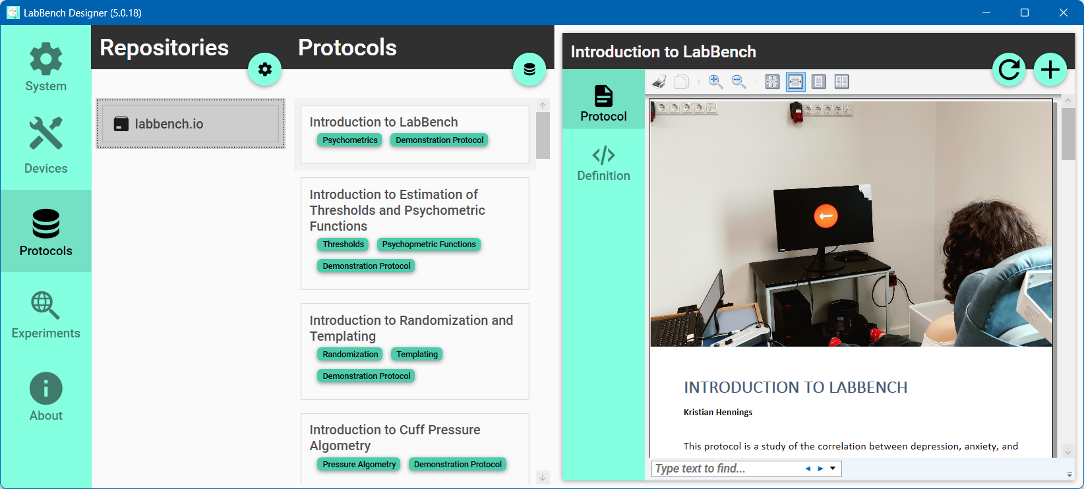
Select Introduction to LabBench
Select the Protocols page
Click the “Install protocol” button
Select the labbench.io repository
Notes:
Joystick Experimental Setup

Slide 7
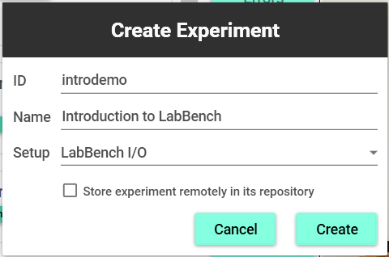
ID of the experiment that must be unique
Name that is displayed to the experimenter
Experimental setup variant
Store the protocol in the repository
Click to create the experiment

Slide 8
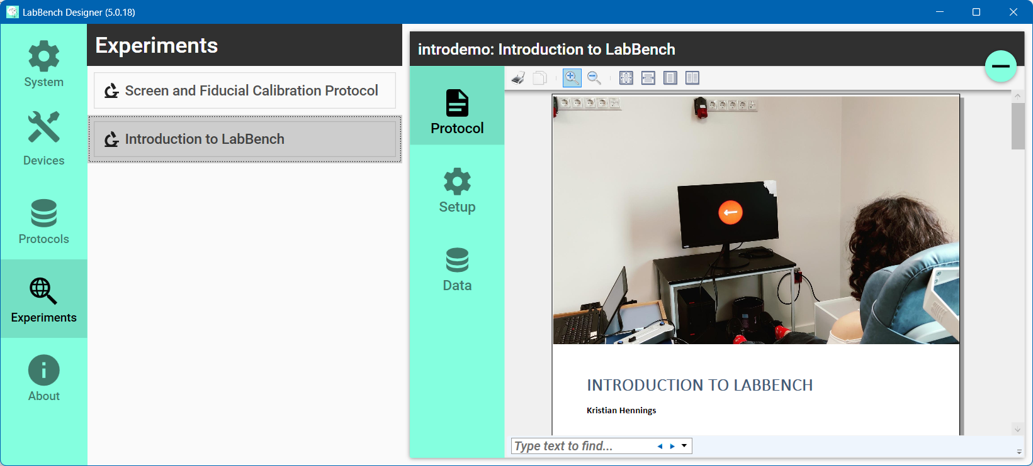
Select the experiment to mange
Select the Experiments page
Content of experiment page
Select the experiment page

Slide 9


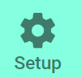




Slide 10
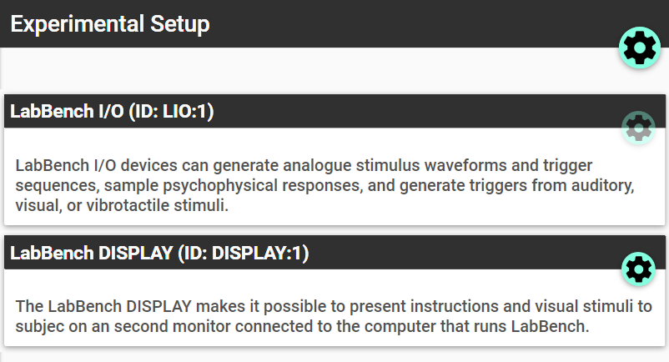
Assign equipment
Configure device

Slide 11
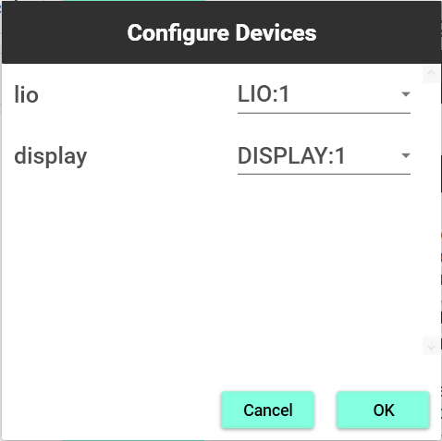
ID of the device in the protocol
Equipment ID from the Devices Page

Slide 12
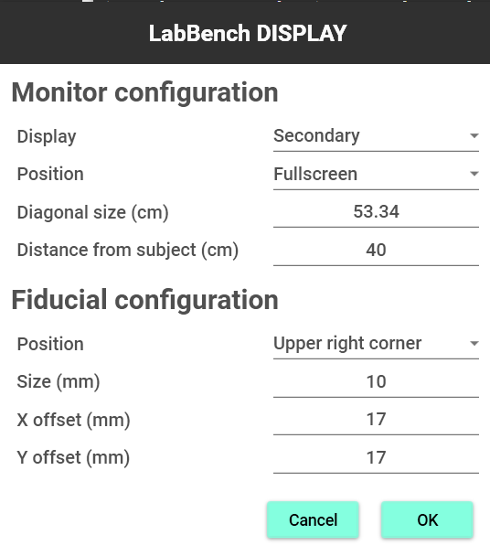

Slide 13
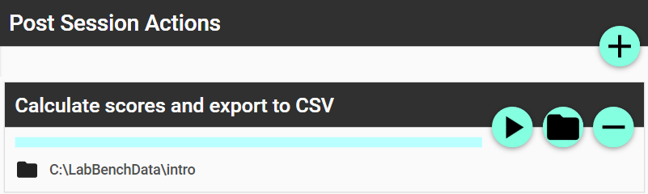
Rerun action
Change output directory

